Slide 1
Context Squeezer
Final year CSE, Generative AI
Cutting tokens from RAG prompts while keeping the answer
Kept 40%
Cut 60%
Siya Dadpe
Gayatri Shisode
BT23F05F013
BT23F05F062
Notes:
Hi, we are Siya and Gayatri. Our project is Context Squeezer. In a RAG system, a retriever hands the language model a lot of text, and most of it is not needed to answer the question. Context Squeezer cuts that text down before the model sees it. The bar on this slide is the idea: keep about 40 percent of the tokens and cut about 60.

Slide 2
Long prompts are slow, costly and noisy
Cost
Speed
Buried answers
APIs bill per token. A longer prompt costs more on every call, and the bill grows in a straight line with its length.
The model reads the whole prompt before it writes the first word, so long prompts make people wait longer.
Models use facts in the middle of a long prompt less reliably than facts at the start or the end (Liu et al., 2023).
In our test data, 8 of the 10 passages in every prompt are distractors.
Context Squeezer
2 / 12
Notes:
RAG systems fetch passages and paste them into the prompt. That causes three problems. First, cost: you pay per token on every call. Second, speed: the model has to read everything before it answers. Third, a long prompt can bury the one fact that matters. The Lost in the Middle paper by Liu and colleagues found models use information in the middle of a long context less reliably. In HotpotQA, the dataset we tested on, each prompt has 10 passages and only 2 hold the answer, so most of the text is distraction.

Slide 3

A filter between the retriever and the LLM
Retriever
Context Squeezer
LLM
Returns 10 passages, about 1,273 tokens
Keeps what answers the question and drops the rest
Reads about 509 tokens at a 40% budget
The retriever and the LLM stay as they are. We tested keeping 40% and 20% of the tokens.
Context Squeezer
3 / 12
Notes:
Context Squeezer sits between the retriever and the language model. Nothing else in the system changes. The retriever still fetches passages, and the model still answers. In our test set an average prompt was 1,273 tokens. Keeping 40 percent leaves about 509 tokens, and we also tried 20 percent.

Slide 4
Three stages, applied in order
1
2
3
Remove filler
Score every word
Fit the budget
spaCy and rules
A small local language model
Information and relevance
spaCy finds sentences, names and numbers. Phrases like “furthermore” and “as previously stated” are cut.
The model rates how surprising each word is. Predictable words go first. Numbers, names and negations are protected.
Sentences are ranked by how much they say and how well they match the question. The best ones stay until the token budget is full.
Context Squeezer
4 / 12
Notes:
The pipeline has three stages. Stage one removes filler. spaCy finds sentence boundaries, named entities and numbers, and a phrase list removes openers like furthermore and as previously stated. Stage two scores each word with a small language model. A word the model could easily predict carries little information, so it is dropped first. Numbers, names and negations such as not are protected. Stage three ranks sentences by how much information they carry and how well they match the question, then keeps the best until the token budget is reached.

Slide 5
243 tokens became 97
Before: first paragraph
After, at a 40% budget
Furthermore, it is worth noting that Nimbus Cloud offers a really generous refund policy on all annual plans. As previously stated in our terms, customers may request a full refund within 30 days of the original purchase date, provided that the account has not exceeded 50 GB of storage in that period.
Nimbus Cloud offers generous refund policy annual plans. terms customers request full refund within 30 days original purchase date provided account not exceeded 50 GB storage period.
Whole example: 243 tokens down to 97, 60% removed. “30 days”, “50 GB” and “not” are still there.
Context Squeezer
5 / 12
Notes:
Here is a real run from our demo. On the left is the first paragraph of a refund policy. On the right is what the model would see at a 40 percent budget. The filler is gone: furthermore, it is worth noting, really, as previously stated. The facts a question could ask about are still there: 30 days, 50 GB, and the word not. The result reads a bit like a telegram, and that is fine, because a language model can still read it. Across the whole example the text went from 243 tokens to 97.

Slide 6
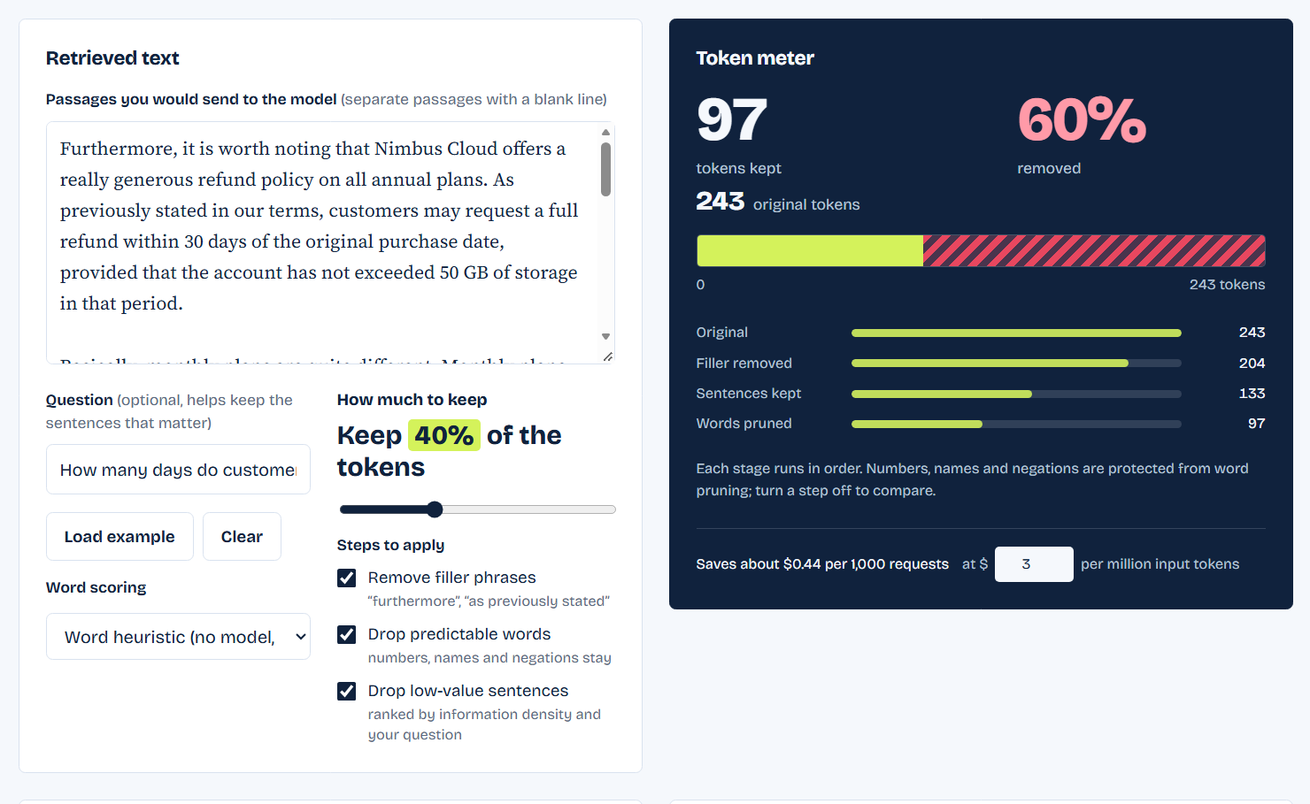
The demo shows every cut
Slider
Sets how many tokens to keep.
Markup
Cut words are struck through. Numbers and negations stay underlined and are never pruned.
Ask the LLM
Sends the full and the squeezed text to a model and shows both answers side by side.
Context Squeezer
6 / 12
Notes:
This is the demo page we built. You paste text and a question, then drag the slider to set the budget. The meter on the right shows tokens before and after. In the text view, struck-through words were cut, and underlined words are protected, like numbers and negations. The Ask the LLM button sends both versions to a model so you can compare the answers. Switch to the live demo here if there is time.

Slide 7
Where generative AI comes in
In the pipeline
Around the pipeline
A small language model scores the text
A reader model checks the result
A separate LLM answers each question twice, once from the full text and once from the squeezed text. Comparing the two answers tells us how much was lost. In the pilot the reader was allam-2-7b on Groq.
Qwen2.5-0.5B runs on the laptop and gives every word a surprisal score in bits. A low score means the word is predictable, so it can go. The code takes any Hugging Face causal model, so a 1B to 3B Llama or Mistral can replace it.
Information Recovery Rate = F1 with squeezed text ÷ F1 with full text
Context Squeezer
7 / 12
Notes:
A language model shows up in two places. Inside the pipeline, a small local model gives each word a surprisal score, which is how unexpected the word is given the words before it. Predictable words carry little information and are dropped first. We tested this with Qwen2.5-0.5B. The proposal asks for a 1B to 3B Llama or Mistral model, and the code can load any of those. Outside the pipeline, a reader LLM answers the same question from the full text and from the squeezed text. The Information Recovery Rate is the F1 score of the squeezed run divided by the F1 score of the full run.

Slide 8
How we tested it
What | Choice
Data | HotpotQA, distractor setting
Questions | First 50 of a fixed 200-question subset (seed 42)
Reader | allam-2-7b through the Groq API
Methods | Full text, Context Squeezer, truncation (first words that fit)
Budgets | Keep 40% and keep 20% of the tokens
Word scorer | Heuristic, no language model in this run
Metrics | Exact match, F1, Information Recovery Rate
Context Squeezer
8 / 12
Notes:
We used HotpotQA in its distractor setting, where every question comes with 10 passages. From a fixed random subset of 200 questions we ran the first 50. The reader model was allam-2-7b, served through Groq, because it was the smallest chat model we could reach. We compared the full text, Context Squeezer, and plain truncation at the same token budgets of 40 and 20 percent. One honest detail: this run used the heuristic word scorer, not the language model scorer.

Slide 9
Fewer tokens, higher scores in the pilot
Method | Tokens | EM | F1 | IRR
Full text | 1,273 | 0.22 | 0.29 | 1.00
Squeezer, keep 40% | 509 | 0.36 | 0.48 | 1.66
Truncate, keep 40% | 509 | 0.32 | 0.42 | 1.43
Squeezer, keep 20% | 255 | 0.40 | 0.54 | 1.86
Truncate, keep 20% | 254 | 0.26 | 0.33 | 1.15
50 questions, one small reader model (allam-2-7b), heuristic word scorer. Treat this as early evidence, not a result we claim for every model.
Context Squeezer
9 / 12
Notes:
These are the pilot numbers. With the full text, the reader got an F1 of 0.29. At a 40 percent budget the squeezer scored 0.48, and plain truncation scored 0.42. At 20 percent the squeezer scored 0.54 and truncation 0.33. IRR is the squeezed F1 divided by the full-text F1, so anything above 1 means the squeezed text did better. We think the small reader is distracted by the long full prompt, but this is a guess and we have not tested it. It is 50 questions and one weak reader, so we call it early evidence.

Slide 10
Answer text survives the cut more often
What this measures
88%
The share of questions where the correct answer is still in the compressed text. 100 questions, no LLM, yes/no questions skipped, heuristic word scorer.
81%
68%
64%
52%
46%
33%
33%
Language-model scorer
19%
On 30 questions it kept the answer 93%, 61% and 50% of the time. That is too few questions to compare it with the heuristic.
Keep 60%
Keep 40%
Keep 20%
Squeezer
Truncation
Random word drop
Context Squeezer
10 / 12
Notes:
This test does not use an LLM at all. For 100 questions we check one simple thing: after compressing, is the correct answer text still in the prompt? At a 40 percent budget the squeezer kept it 81 percent of the time, truncation kept it 46 percent, and dropping random words kept it 33 percent. At 20 percent the gap is wider. The language model scorer was tried on 30 questions and got 93, 61 and 50 percent, which is close to the heuristic and too small a sample to say more.

Slide 11
What these results do not show
A small sample
An uneven comparison
50 questions and one reader that scored just 0.29 F1 on the full text. A few answers can move the numbers.
The squeezer reads the question when it picks sentences. Truncation does not. Part of the gain may come from that, not from pruning words.
The heuristic scorer
Scores above 1.0
The pilot used the word heuristic. The language-model scorer has only had a 30-question proxy run so far.
The small reader may have been distracted by the full prompt. We have not tested that, and we do not claim it holds for stronger models.
Context Squeezer
11 / 12
Notes:
Four things to keep in mind. The pilot is only 50 questions and one weak reader, so a handful of answers can change the picture. The comparison with truncation is uneven, because the squeezer uses the question to pick sentences and truncation does not. We still need a question-aware baseline and the ablations to separate the effects. The pilot used the heuristic scorer, so it says nothing yet about the language model scorer. And a score above 1 is surprising. Our guess is that the full prompt distracts a small model, but we have not tested it.

Slide 12
What we do next
Run all 200 questions with a stronger reader
Score with a 1B to 3B Llama or Mistral model
Add ablations and a question-aware baseline for truncation
Compare against LLMLingua
Test long prompts where the key passage sits in the middle
Related work
Selective Context, LLMLingua, LongLLMLingua and LLMLingua-2 also compress prompts. Liu et al. (2023) show how models lose facts in long contexts.
Questions?
Context Squeezer
12 / 12
Notes:
Next we want to run all 200 questions with a stronger reader, and score words with a 1B to 3B Llama or Mistral model as the proposal says. We will add the ablations and a baseline that also uses the question, so the comparison is fair, and compare against LLMLingua. We also want to test long prompts where the key passage sits in the middle. Related work includes Selective Context, LLMLingua, LongLLMLingua and LLMLingua-2, plus the Lost in the Middle paper by Liu and colleagues. Thank you, we are happy to take questions.

